Slide 1
CREDIT CARD USAGE SEGMENTATION
DONE BY
SAROA

Slide 2
AGENDA
01 Introduction
02 Data Collection
03 Preprocessing
04 EDA
05 Methodology
06 Model Evaluation
07 Conclusion

Slide 3
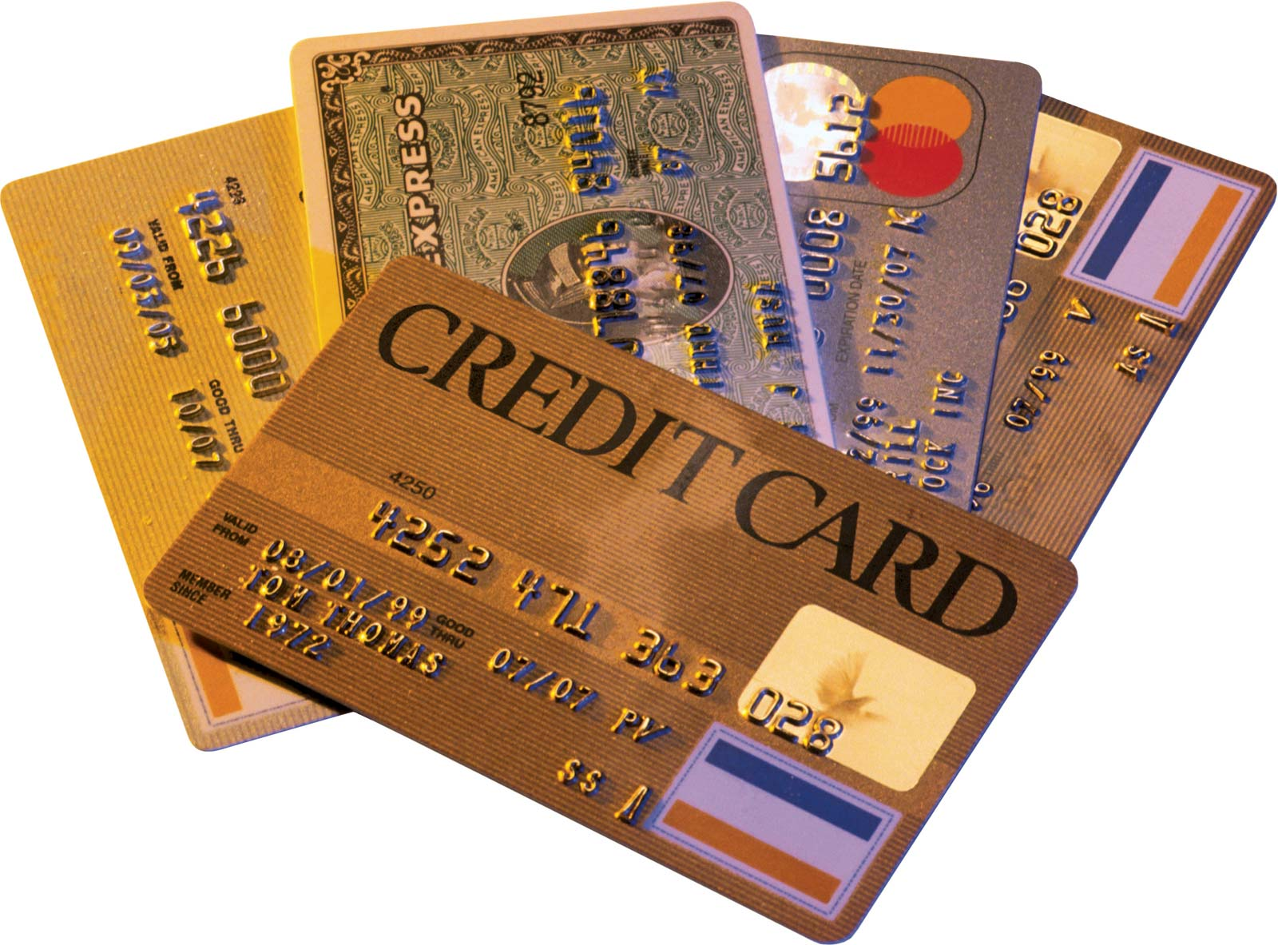
INTRODUCTION
Credit card usage segmentation involves dividing customers into distinct groups based on their spending patterns, transaction behaviors, and demographics.
The primary objectives of segmentation include targeted marketing, risk management, product development, and revenue optimization.
Key factors in segmentation include spending patterns, payment behavior, demographic characteristics, product usage, and credit risk.

Slide 4
DATA PREPROCESSING
Dataset Features The dataset contains 18 variables related to credit card usage and customer behavior.
Data Cleaning The CUST_ID column was dropped as it wasn't relevant for analysis. For missing values, CREDIT_LIMIT had only one missing value, which was filled with the mean.
For MINIMUM_PAYMENTS, missing values were handled based on the payment status: if payments were zero, MINIMUM_PAYMENTS was filled with zero; otherwise, it was filled with the mean.
Feature Scaling: MinMax scaling was applied to the dataset. This choice was made after testing both MinMax and standard scaling methods, with MinMax scaling yielding better model performance.

Slide 5
DATA COLLECTION
BALANCE: The current amount owed on the credit card. It reflects the user's spending and payment activity.
PURCHASES: Total amount spent on the credit card. This includes all types of purchases made by the customer.
CASH_ADVANCE: The amount of cash taken out against the credit card limit. It indicates the user's need for cash and potential financial behavior.
CREDIT_LIMIT: The maximum amount that can be charged to the card. It defines the credit capacity available to the customer.
PAYMENTS: Total payments made towards the credit card balance. This shows the customer's payment behavior and financial responsibility.
TENURE: The number of months the customer has been with the credit card issuer. It provides insight into customer loyalty and engagement.

Slide 6
VISUALIZING DISTRIBUTIONS OF NUMERICAL FEATURES
Most features, such as BALANCE, PURCHASES, CASH_ADVANCE, MINIMUM_PAYMENTS, and CREDIT_LIMIT, exhibit right-skewed distributions, indicating that a majority of the data points are concentrated on the lower end, while a few outliers exist on the higher end.
Features like PURCHASES_FREQUENCY, CASH_ADVANCE_FREQUENCY, and INSTALLMENTS_FREQUENCY show a concentration around specific values (e.g., 0 and 1).
Features like ONEOFF_PURCHASES and CASH_ADVANCE have a significant portion of values close to zero, indicating that many customers do not use these services frequently.
Some features like TENURE and PRC_FULL_PAYMENT seem to have a limited range of values, potentially because these are categorical or restricted values (e.g., tenure capped at 12 months).

Slide 7
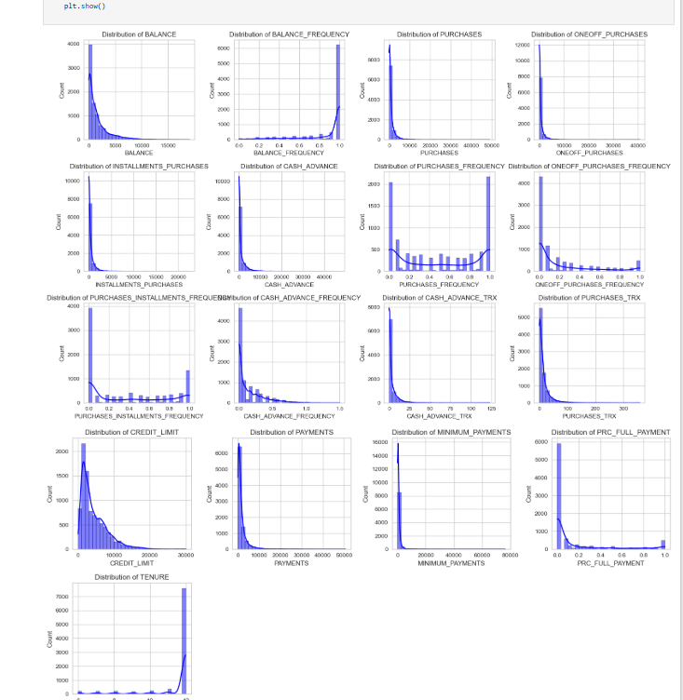

Slide 8
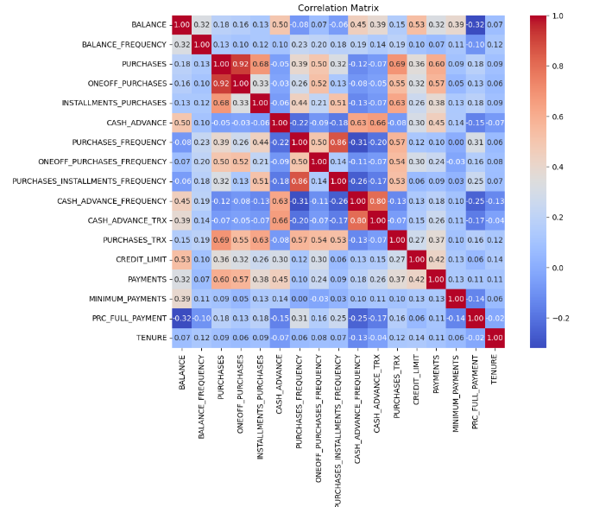
CORRELATION MATRIX
PURACHASES_INSTALLMENTS_FREQUECY has strong positive correlation with PURCHASE FREQUENCY
BALANCE has a strong negative correlation with PRC_FULL_PAYMENT
TENURE has almost no correlation with any (No linear relationship)
PURCHASES has a positive correlation with One-Off purchase of 0.92.
PURCHASES FREQUENCY has a positive correlation with PURCHASES INSTALLMENT FREQUENCY of 0.86.
CASH ADVANCE_TRX has a positive correlation with CASH ADVANCE_FREQUENCY of 0.8.

Slide 9
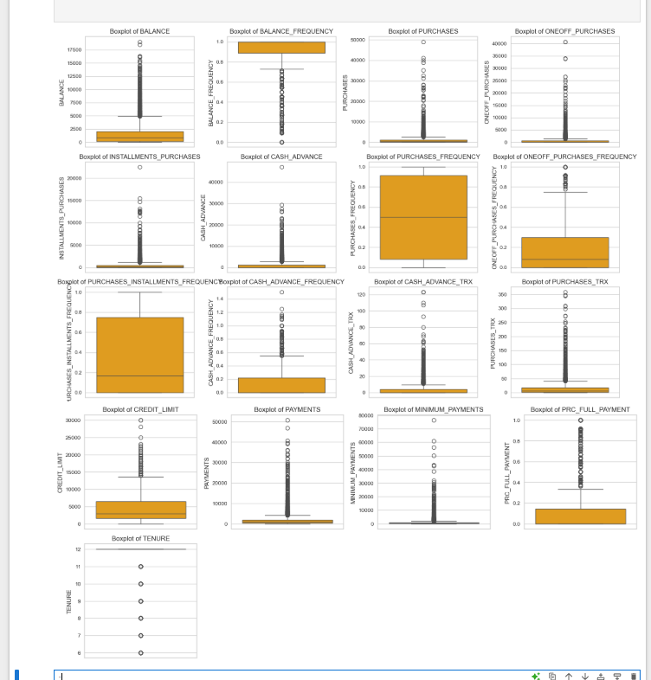
EXPLORATORY DATA ANALYSIS
BALANCE and PURCHASES: These features exhibit a wide range of values, with a significant number of outliers indicating that some customers have much higher balances and purchase amounts compared to others.
CREDIT_LIMIT and PAYMENTS: The distributions for these features are also right-skewed, with outliers suggesting that while most customers have moderate credit limits and payments, a few have significantly higher values.
NO OUTLIERS in "PURCHASES_FREQUENCY" "PURCHASES_INSTALLMENTS_FREQUENCY"

Slide 10
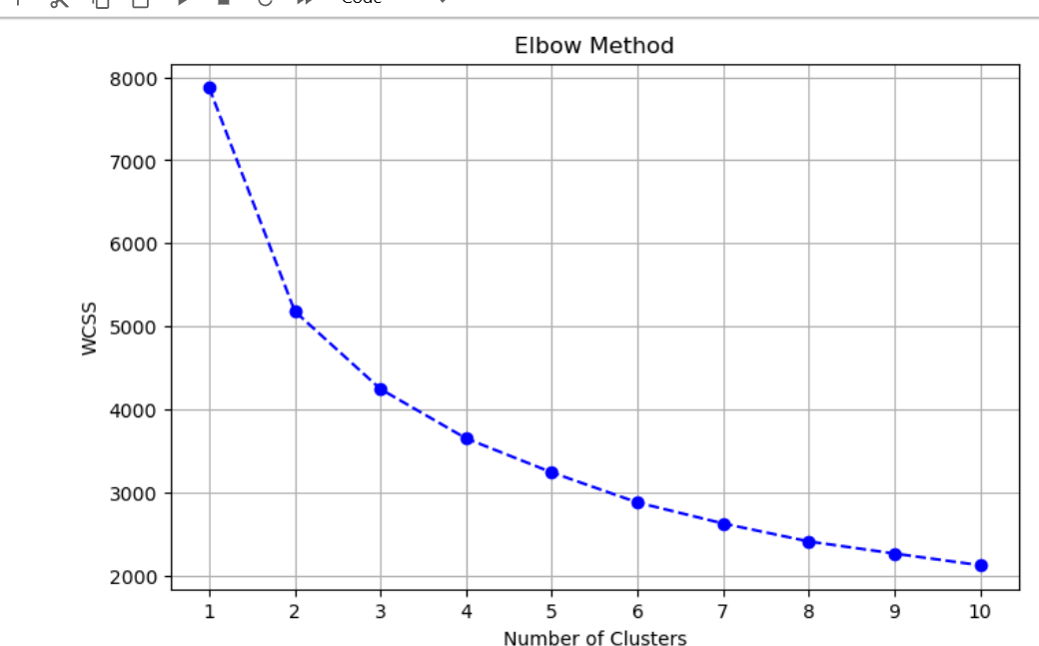
METHODS
K-Means Clustering: Partitions data into K clusters by minimizing the sum of squared distances within each cluster. It’s a simple, iterative algorithm often used for its speed and efficiency.
Hierarchical Clustering: Agglomeratively merges clusters to minimize within-cluster variance using Ward linkage. Flexible with no need for a predefined number of clusters. Other linkages include single, complete, and average.

Slide 11
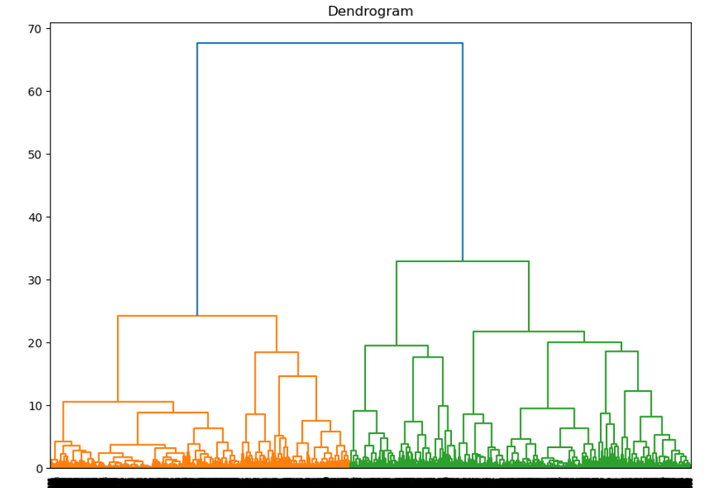
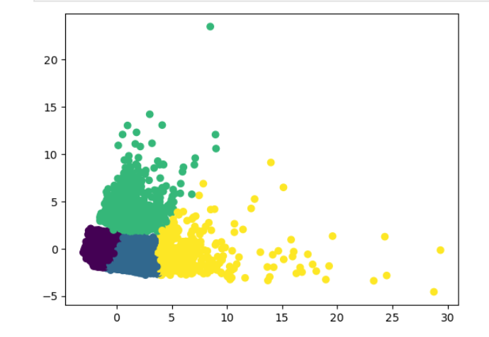
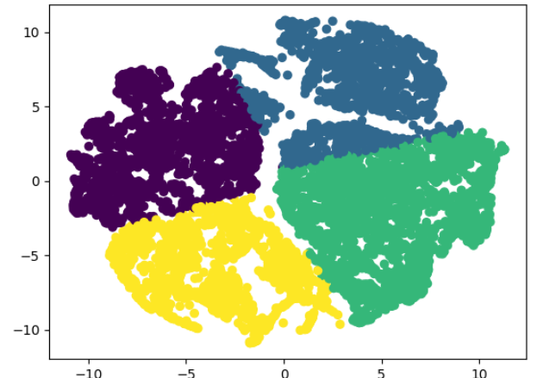
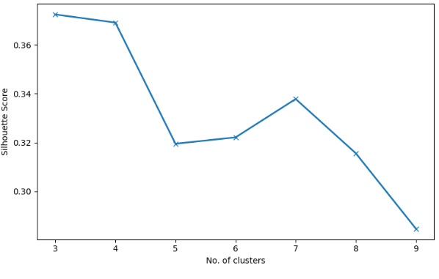
MODEL CLUSTER VISUALIZATION
PCA 2D
T-SNE 2D
Silhouette Score for KMeans

Slide 12
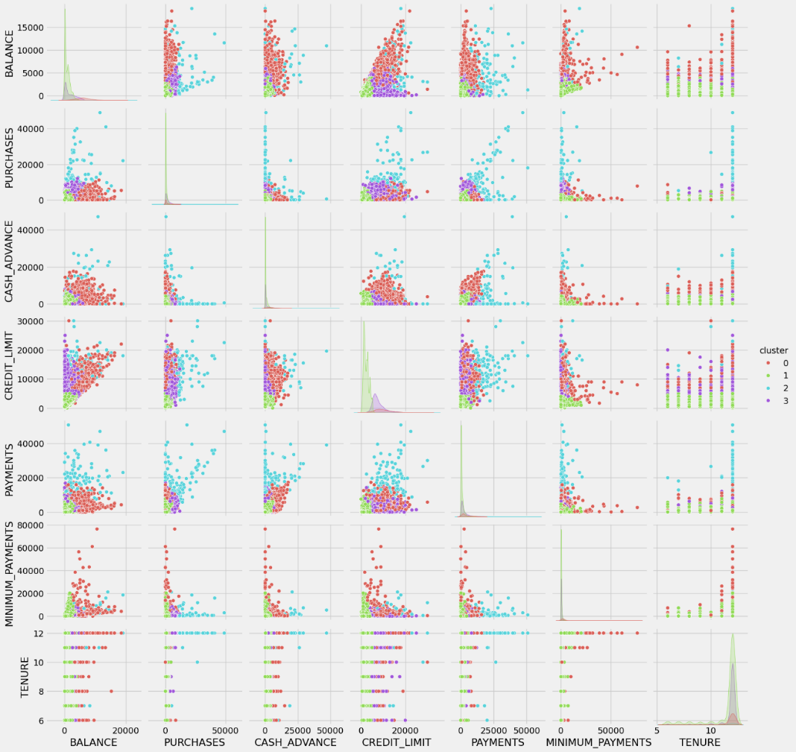
CONCLUSION
The pair plot presents a scatterplot matrix of features, with clusters highlighted using different colors (Red for Cluster 0, Green for Cluster 1, Blue for Cluster 2, and Purple for Cluster 3).
This visualization helps in understanding how different features separate the data into distinct clusters, providing insights into the distribution and overlap of clusters.

Slide 13
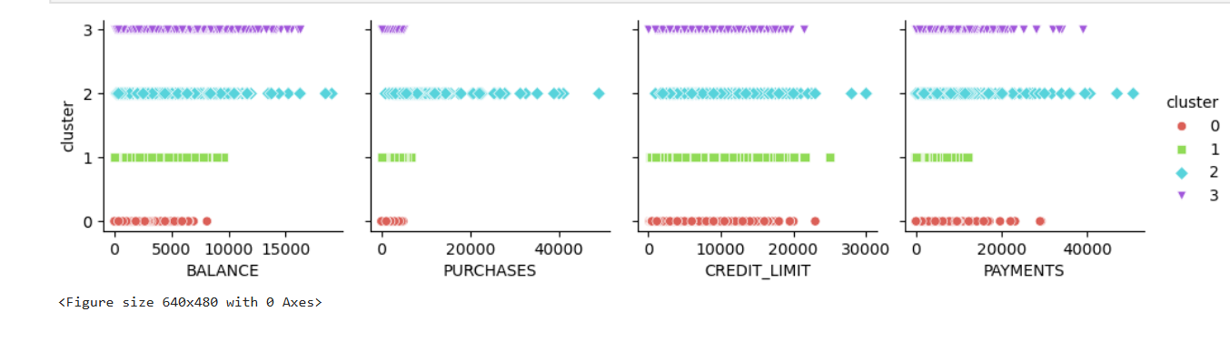
CLUSTER ANALYSIS
Cluster 0 (Red): Customers in this group tend to have the lowest balances, purchases, credit limits, and payments. They are likely light users of credit cards, possibly new or infrequent customers who do not rely heavily on credit.
Cluster 1 (Green): This cluster represents customers who have moderate balances and credit limits, but relatively low purchases and payments. These customers may manage their credit conservatively, with a focus on maintaining a steady but controlled use of their available credit. controlled use of their available credit.
Cluster 2 (Blue): Customers in this segment have higher balances and purchases, along with significant credit limits and payments. These are likely active credit card users who utilize their cards for various transactions and manage larger amounts of money, indicating they might be high-value customers.
Cluster 3 (Purple): This group includes customers who have high balances, credit limits, purchases, and payments. They likely use their credit cards extensively, not only for purchases but also for large payments, which suggests they might be leveraging their credit for substantial financial activities or investments.

Slide 14
BUSINESS INSIGHTS TO IMPROVE CREDIT CARD USAGE
Cluster 0 (Red):
Educate customers on credit card benefits.
Offer small cashback or discounts for initial usage.
Cluster 1 (Green):
Introduce rewards for consistent, low-risk spending.
Provide installment plans for larger purchases.
Cluster 2 (Blue):
Personalize rewards like travel perks and loyalty points.
Promote additional financial products (e.g., loans, insurance).
Cluster 3 (Purple):
Offer higher credit limits and exclusive premium benefits.
Focus on retention with personalized loyalty programs.

Slide 15
QUESTIONS ?

Slide 16
Thank You!

